Slide 1
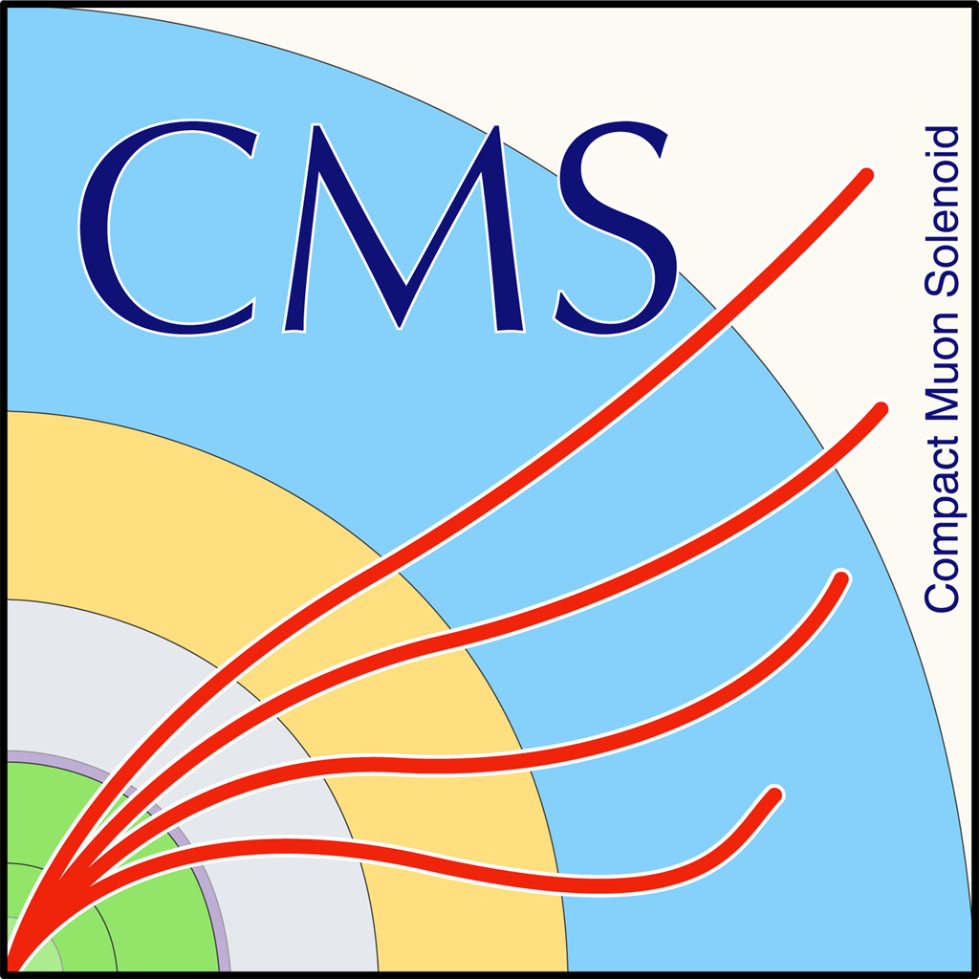

Progress Report
Papakrivopoulos Ioannis

Slide 2
Status
DT
Configurtion Database
Possibility of monitoring MicroTCA crates
Again problems with the alarm screen
Change of component dependencies caused problems in project creation
Central project merging:
Modified components
Tested project merging
System recovery
BRIL/ECAL problem with mainframe communication

Slide 3
DCS
Study trigger behavior
Specific rate (Events/sec) for whole HLT menu
Prescale (run the trigger every X events)
How will our trigger behave?
Study rate offline

Slide 4
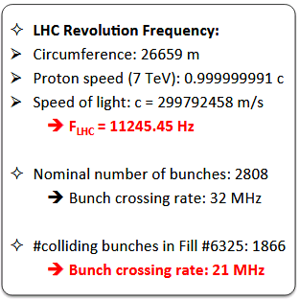
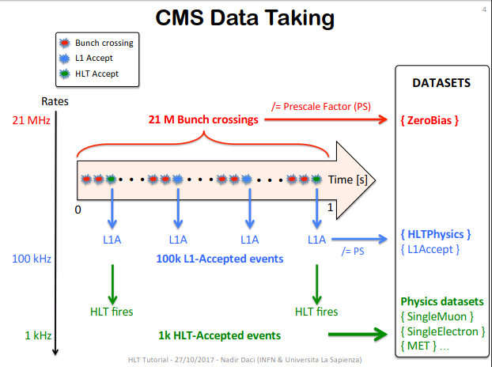
Trigger Studies
Lumi section: Time interval used in cms
Every lumi section is the time required for 2^18 LHC orbis
2^18/11245.45 = 23.31 sec

Slide 5
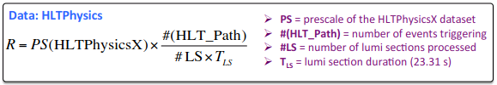

Trigger Studies
Rate calculation:
Rate calculation normalized:

Slide 6
Trigger Studies
Original talk link:
HLT Rate Studies
Tutorial indico link:
HLT tutorial (27 October 2017) · Indico
Tutorial twiki link:
Trigger Tutorial 2017 twiki

